Slide 1

Antenna Theory
Morning Lab
The Handsome Seastars

Slide 2
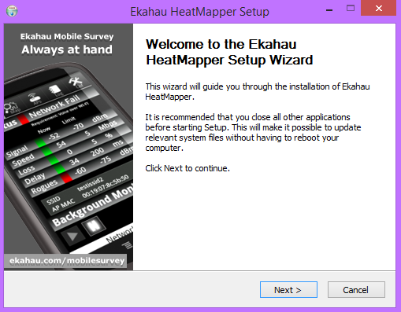
Ekahau HeatMapper Installation
Start by downloading the installer
Link Here: http://sw.ekahau.com/download/client/Ekahau%20Heatmapper-Setup.exe
Click “next” until it installs
The only option to change would be install location which is up to the user’s preference

Slide 3
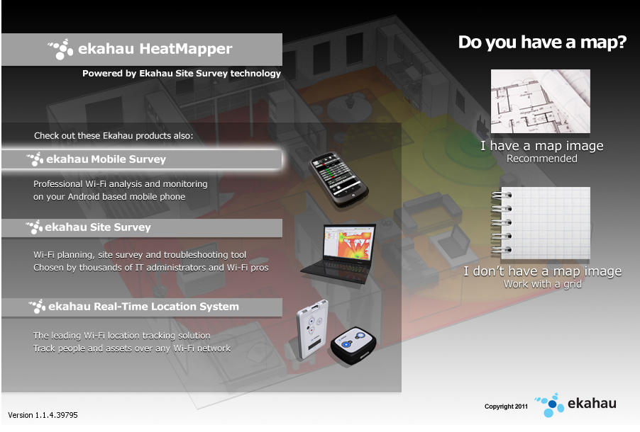
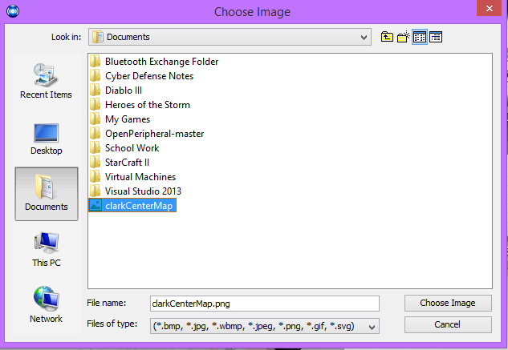
Ekahau HeatMapper
Once HeatMapper is installed and opened, you can select “I have a map image” to start
Selecting “I don’t” will start you with a blank grid (Not Recommended)
Now you can select your image and hit “Choose Image”
We found our map on the UTD website

Slide 4
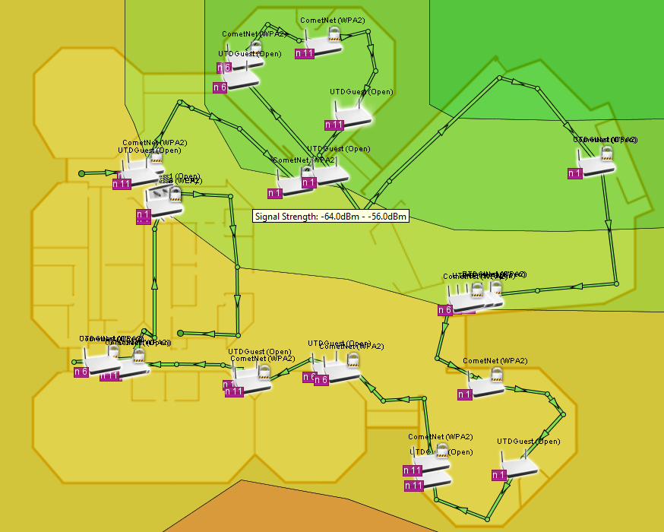
Heatmapping the Building
In order to heat map the building we must first “Survey” it.
Take laptop and stand up
Left-click on the map at the current location
Start walking around slowly and frequently left click your current location
Right click to end the survey
You may left click again to continue the survey from another location

Slide 5
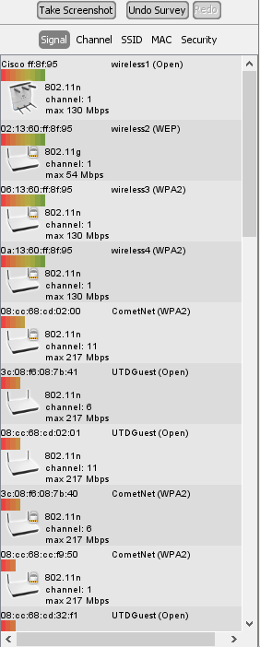
Ekahau Heatmapping
Ekahu now generates the coverage areas and all the access points it discovered.
Hover over and access point to see it’s coverage zone
You can see all access points on the left
The can be sorted by MAC, SSID, Signal, Channel, and Security
Now with an access point hovered over
we can see the donut shapes created
by the antenna
The coverage areas shown
are shown in strength ranging from
Green (Strong) to Red (Weak)

Slide 6
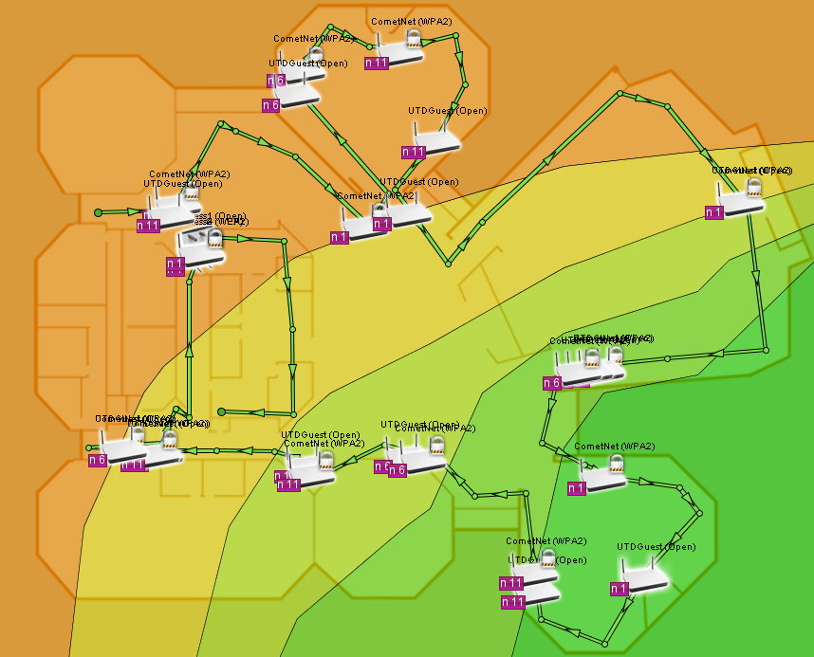
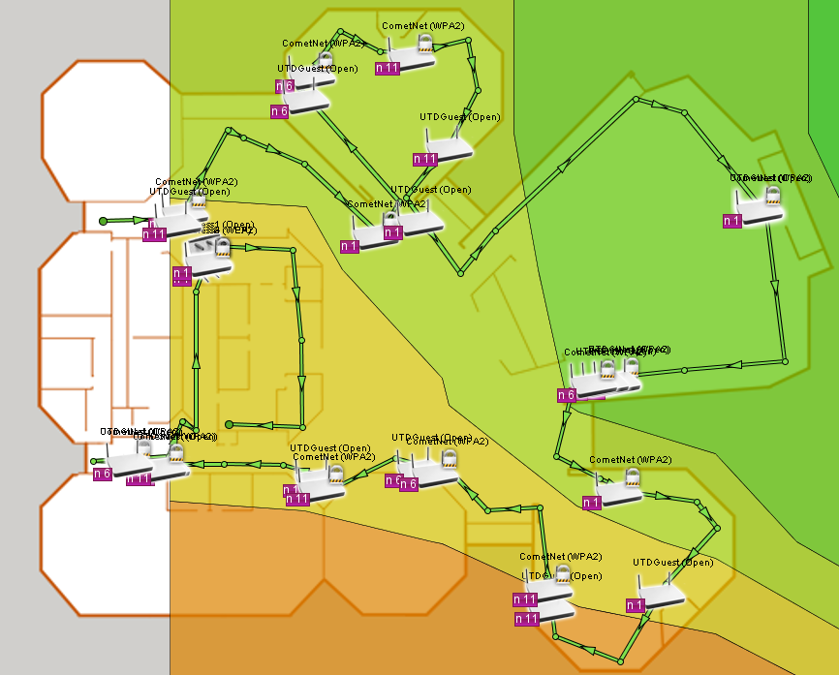
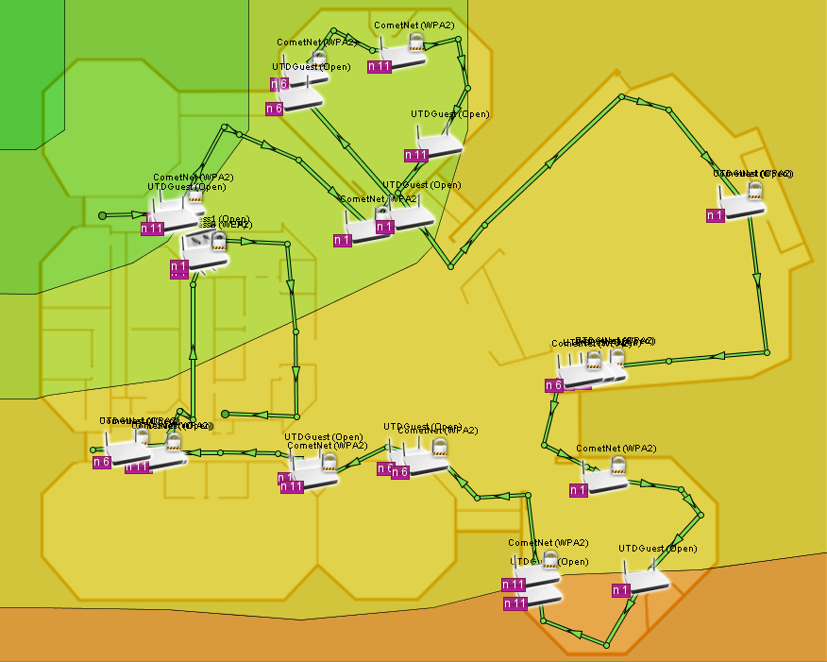
Remapping the Clark Center
Primarily it looks like the access points are pulling wifi from outside of the Clark Center.
Majority of the stronger signal strength is coming from outside the building
As a result most access points are right on the edge of the center and not anywhere near the classrooms they need to be providing wifi for.
Moving or even adding even one and maybe two access points closer towards the center and nearer to the classrooms would improve wifi.

Slide 7
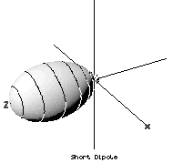
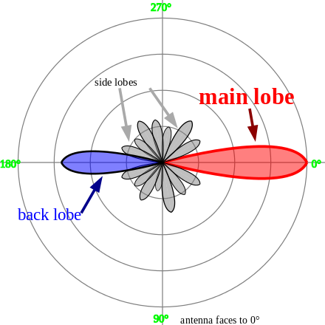
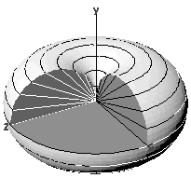
Radiative Patterns
Radiative pattern: models the directions and distances radio waves radiate from an antenna.
Typical pattern.
Main/back lobes: should be pointed toward where you want strongest signal
Side lobe: where you need less signal
Remember the 90 degree angle rule
For a horn antenna
Vertical antenna.
Notice the donut

Slide 8
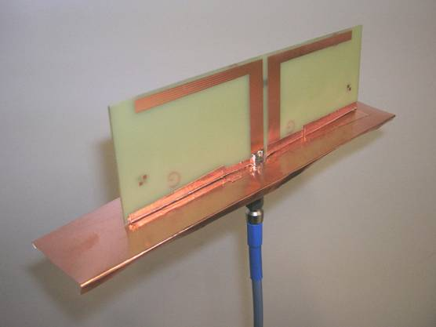
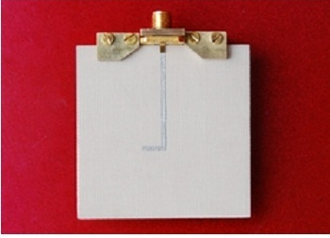
Patch Dipole
Among the easiest to create and customize
Thin, light, simple
Two sheets of metal from the radio

Slide 9
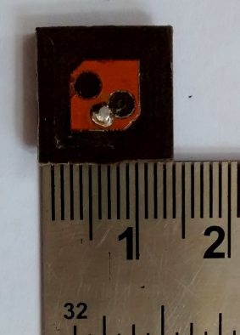
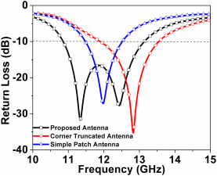
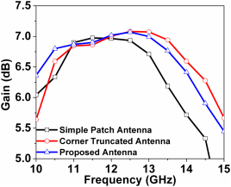
Corner Patch
Corner patch: refers to a (microstrip) patch antenna with cut corner
Bandwidth improved 123% from regular patch antenna if you cut 2 corners
Satellites, radar, cell phones…
Gain comparison.
1 corner and 2 corner truncated antennas have HIGHER GAIN across the board
Patch antennas show LESS RETURN LOSS
Example 2-corner truncated antenna

Slide 10
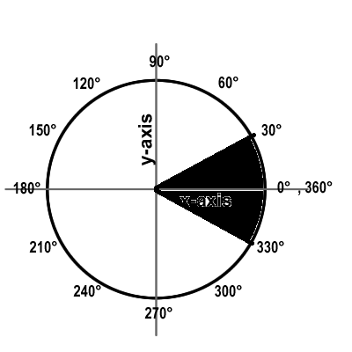
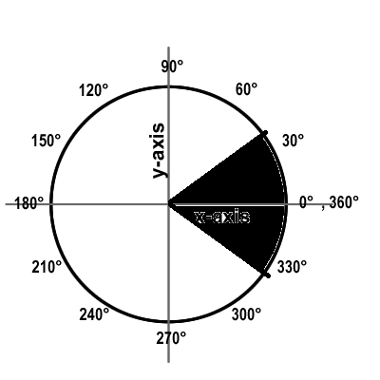
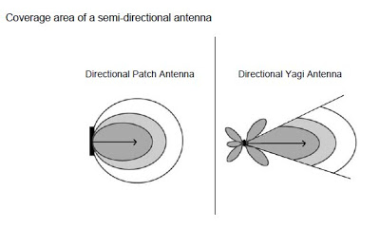
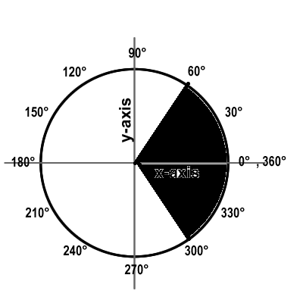
Semi Directional Antennas (60°, 90°, 120°)
Designed to emit waves towards a general direction, cover a 60°, 90°, 120° area
Short-medium distance comms
Patch, panel, yagi antenna types
60° coverage area
90° coverage area
120° coverage area

Slide 11
Smart Antenna
Smart antenna (aka adaptive array, multiple antenna, MIMO/SIMO/etc [multiple input, multiple output]: uses smart signal processing algorithms to identify where inbound signals are coming from, then track the source and form a signal beam that’s focused on a certain target
Used especially in cell towers and cell phones

Slide 12
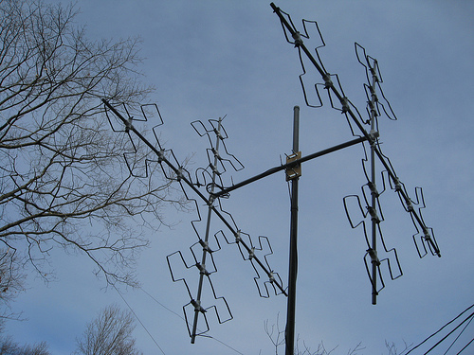
Fractal
In antennas: antenna using a fractal, symmetric, design to maximize as much surface area to transmit signals as possible
Work well with many different frequencies simultaneously since they’re not limited by length
Ham radio antenna using a fractal design
An example of a fractal pattern

Slide 13
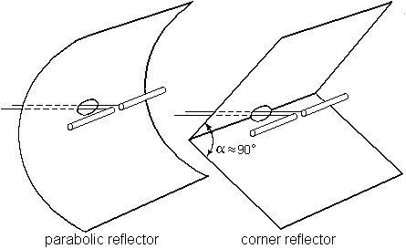
Reflector Antenna
Dipole antenna placed between 2 sheets to reflect the metal
Operates on VHF and UHF frequencies
Creates directional signal

Slide 14
Wireshark
The Handsome Seastars

Slide 15
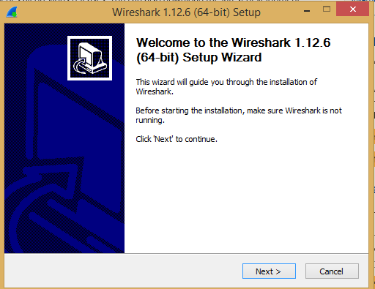
Wireshark Installation
Start by downloading your installer at wireshark.org/download.html

Slide 16
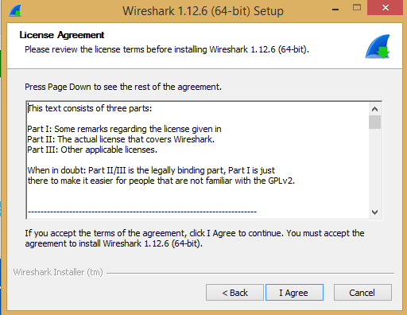
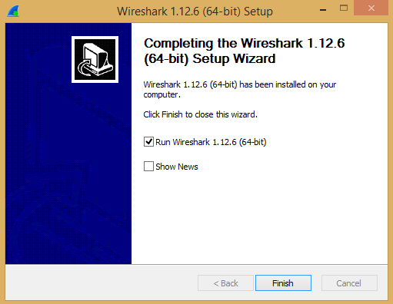
Wireshark Installation cont.

Slide 17
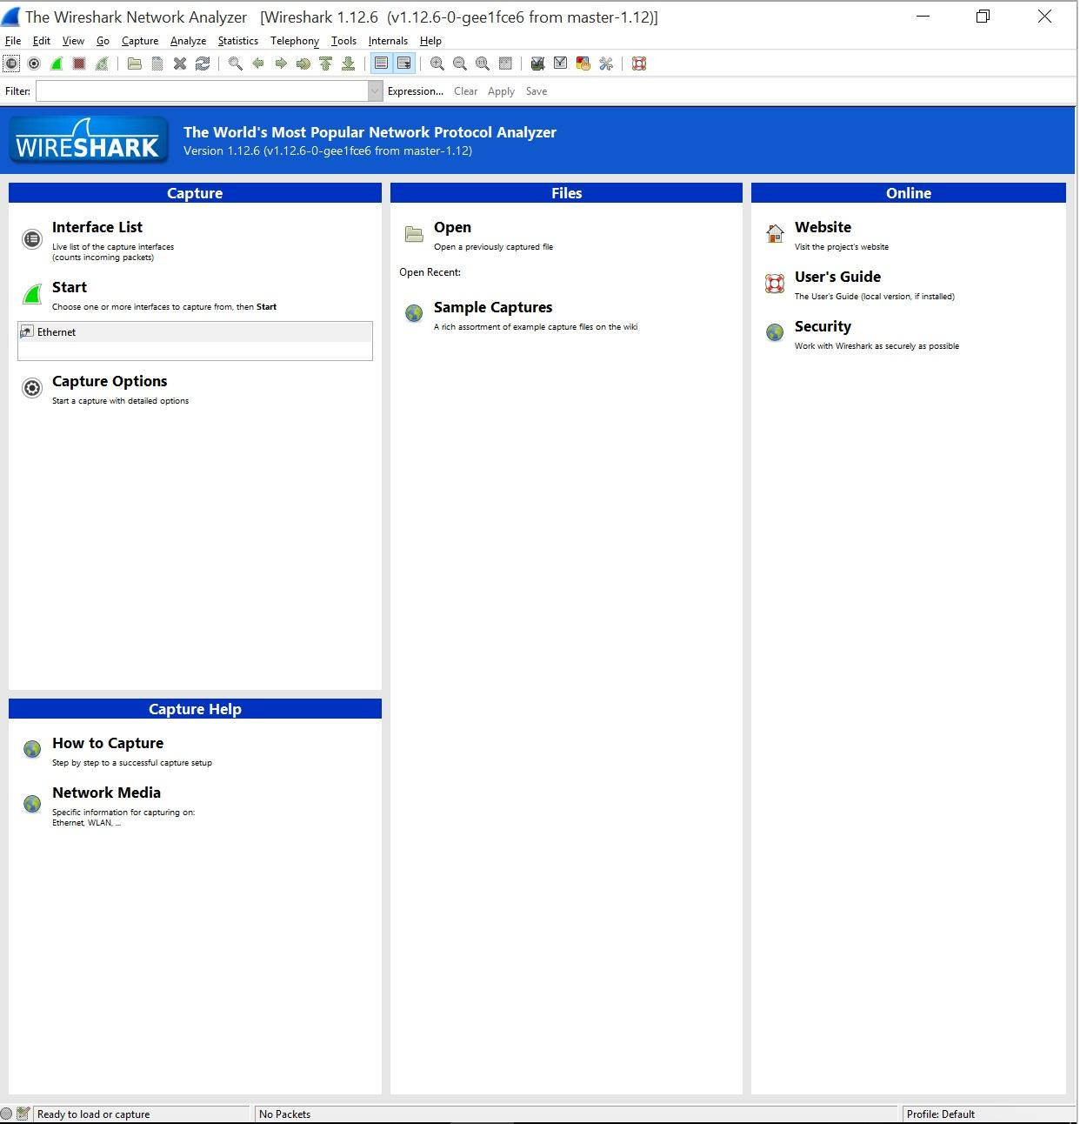
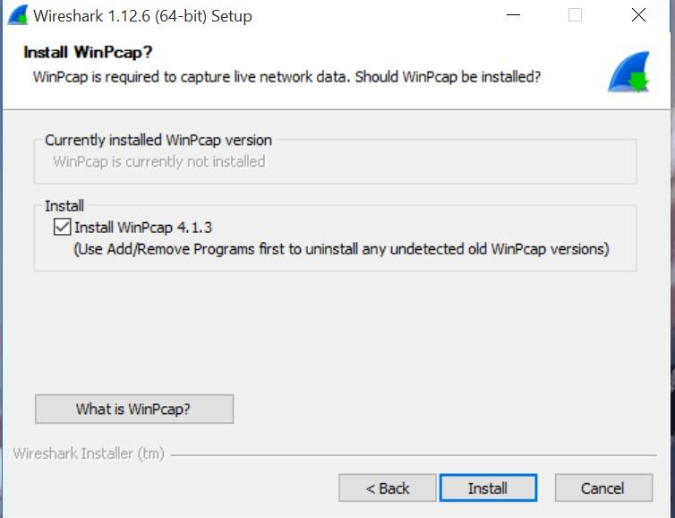
Wireshark Installation cont.

Slide 18
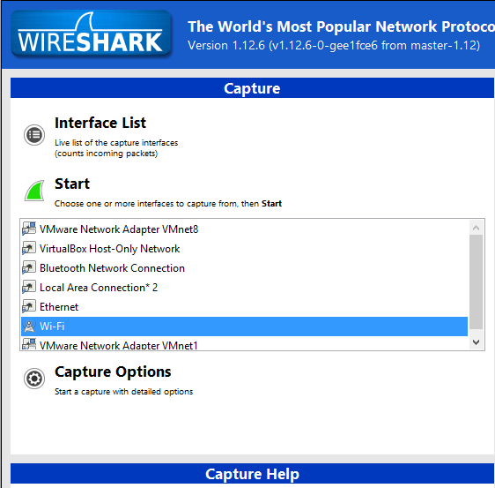
Wireshark
Select an interface to
capture packets from. Then press “Start” to start capturing packets.

Slide 19
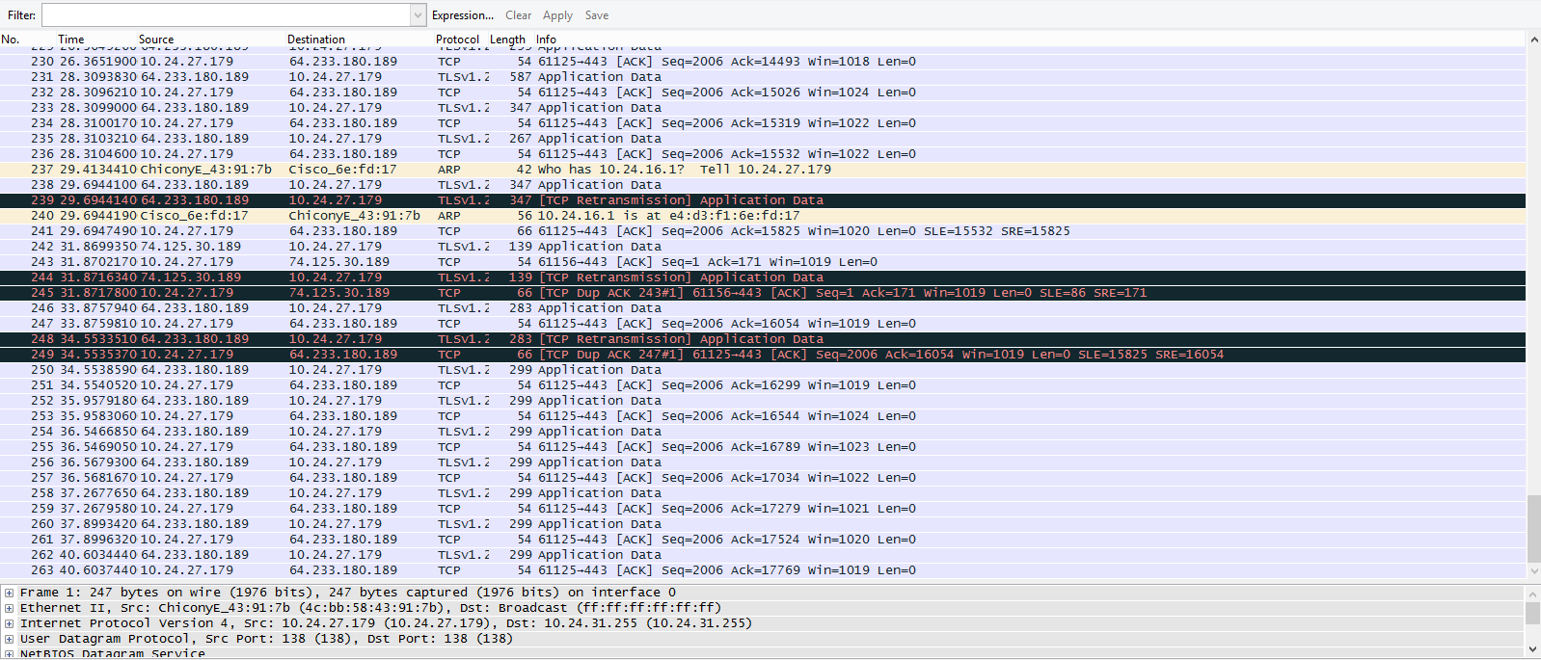
Wireshark

Slide 20
Sources
Howtogeek.com
utd.com
iiitdmj.ac.in
Ekahu Heatmapper Documentation
does this look like the face of mercy

